Slide 1
full stack web development project
RAHULSARANGA 15-05-2024

Slide 2
Introduction To Job Portal
Welcome to our open-source job portal project, designed to connect job seekers with the latest job listings. This dynamic web application will offer students hands-on experience in frontend and backend development, user authentication, and job listing management

Slide 3
FILE FOLDERS IN PROJECT
Our project includes essential files for web development HTML files such as `index.html` and `dashboard.html` form the main user interfaces for job listings and user dashboards respectively CSS files `style.css` and `dashboard.css` handle the visual presentation ensuring a cohesive design across pages JavaScript files `main.js` `dashboard.js` and potentially `login.js` manage dynamic content user interactions and authentication features These files collectively support the functionality and user experience of our job portal application

Slide 4
FEATURES AND FUNCTIONALITY
The features and functionality of the project are designed to ensure a comprehensive and efficient user experience. Key features include:
User Authentication: Secure login and registration system to ensure data privacy and user-specific access.
Data Management: Efficient handling of user data with CRUD (Create, Read, Update, Delete) operations supported by robust database.
Interactive User Interface: A responsive and intuitive frontend that enhances user interaction and accessibility across various devices.
Real-time Updates: Live data updates and notifications to keep users informed of the latest changes and events within the application.
Data Visualization: Dynamic charts and graphs to help users easily interpret and analyze data.
Scalability: The architecture supports scaling, ensuring the application can grow with increasing user demand without compromising performance.
These features collectively aim to provide a secure, efficient, and engaging platform for users.

Slide 5
THE SCREENSHOTS OF THE PROJECT OF ALL THE PAGES OF THE PROJECT

Slide 6
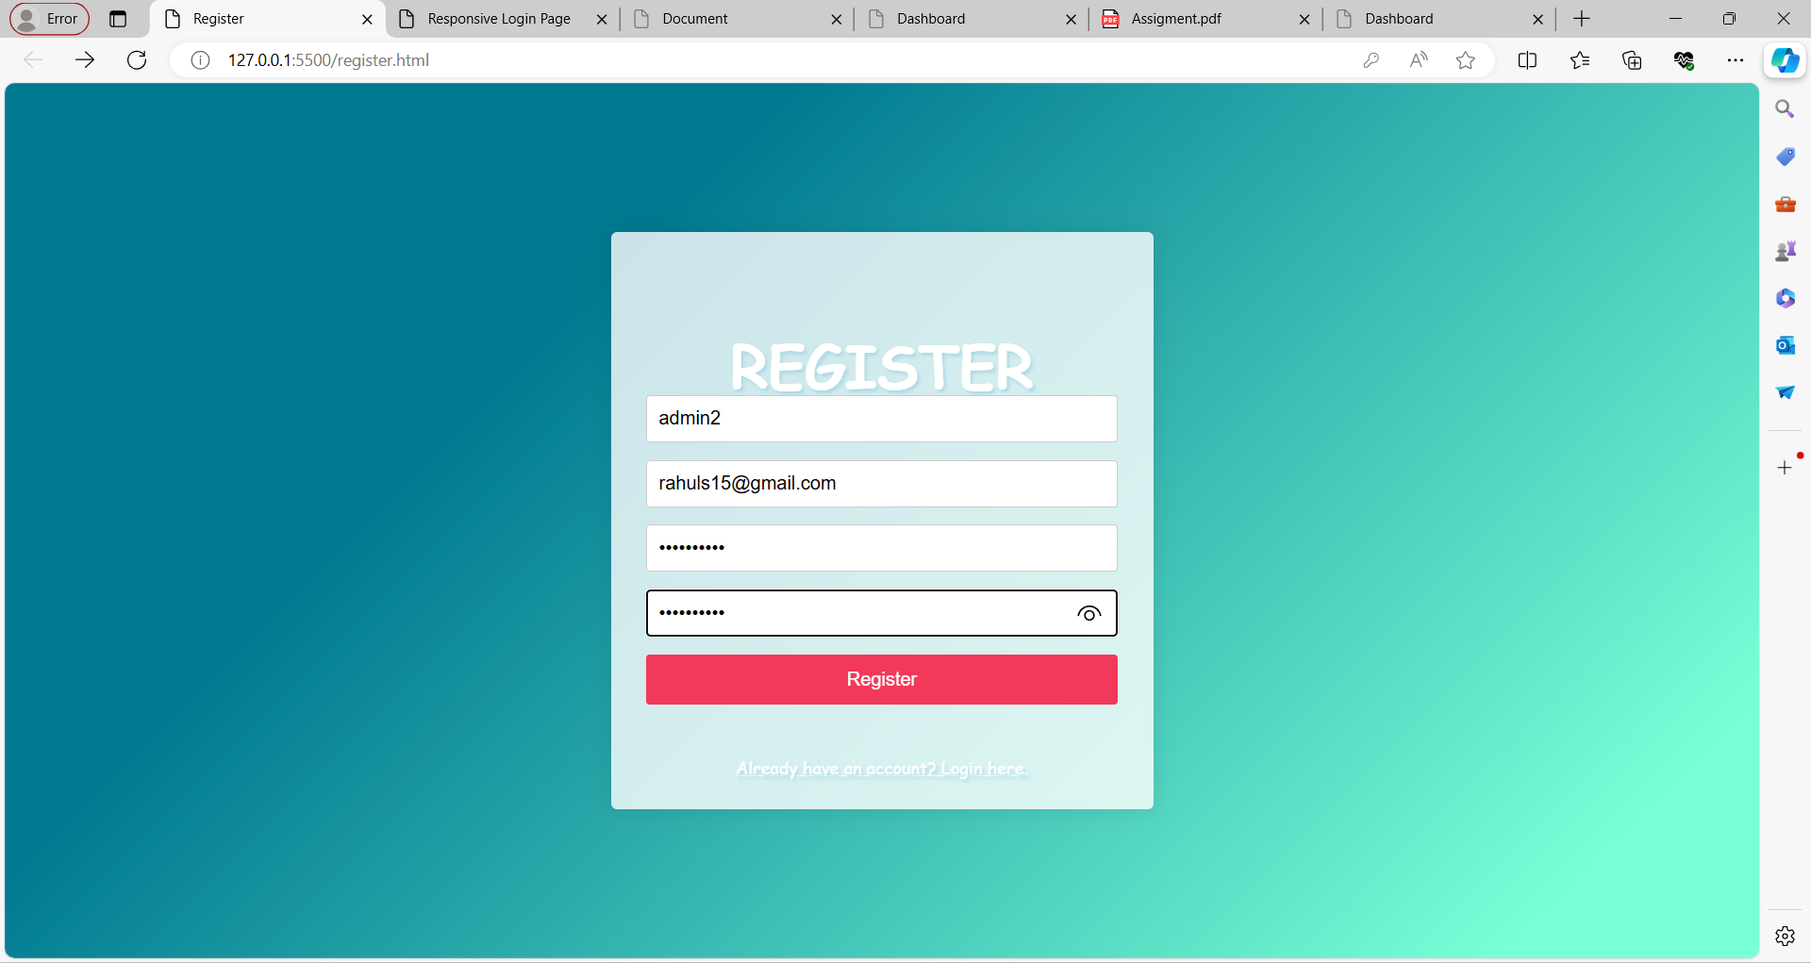
THE SCREEN SCREENSHOT OF THE REGISTRATION FORM

Slide 7
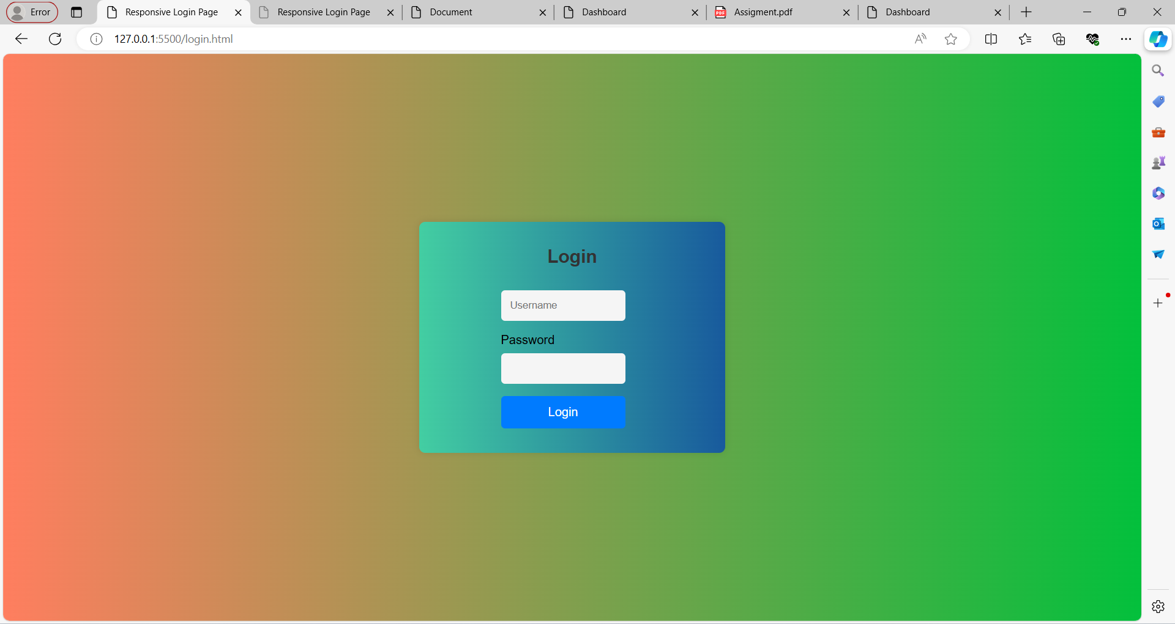
THE SCREENSHOT OF THE LOGIN PAGE

Slide 8
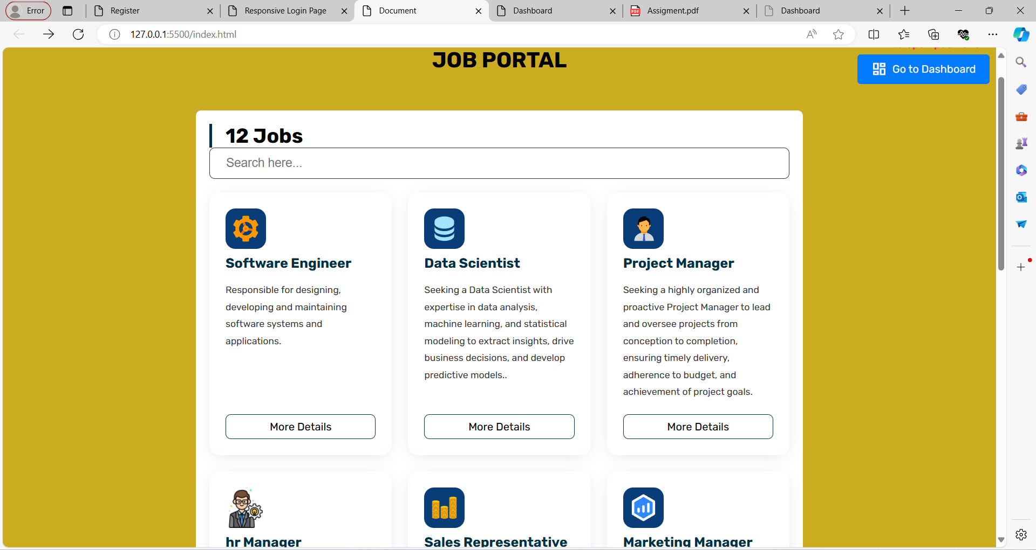
THE SCREENSHORT OF HOME PAGE

Slide 9
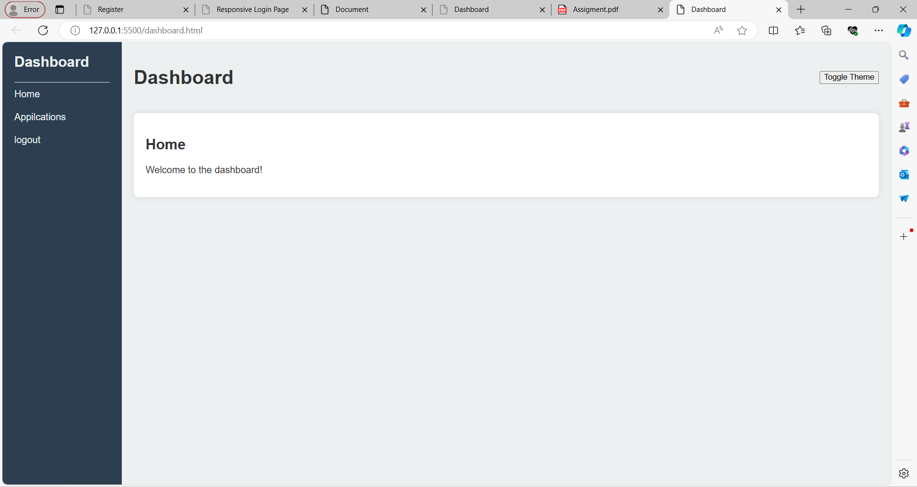
THE SCREENSHORT OF THE DASHBOARD PAGE

Slide 10
THE CHALLENGES FACED IN THE PROJECT
The project encountered challenges such as integrating complex third-party APIs, ensuring compatibility across multiple platforms and devices, managing large volumes of concurrent user data transactions, and optimizing performance to meet stringent response time requirements. Additionally, adapting to evolving security protocols and maintaining consistency in data synchronization posed significant hurdles throughout the development process.

Slide 11
CONCLUSION
In summary, the development of the open-source job portal has been a significant achievement, focusing on accessibility, scalability, and user-centric design. Throughout the project, challenges such as integration complexities and user interface refinement were successfully addressed through iterative development and community feedback. Looking ahead, continuous updates and community contributions will sustain the portal's relevance and effectiveness, fostering a vibrant ecosystem for job seekers and employers alike.

Slide 12
THANK YOU
GIT HUB:https://github.com/rahul4823/OPEN-SOURCE-JOB-PORTAL.git

